Slide 1
Content
Last presentation review
Testing the dual-ascent algorithm: random walk problem (modified)
Future lines (06/04/2017)
DANIEL GARCÍA-OCAÑA HERNÁNDEZ

Slide 2
Content
LAST PRESENTATION REVIEW
Testing the dual-ascent algorithm: random walk problem (modified)
Future lines (06/04/2017)

Slide 3

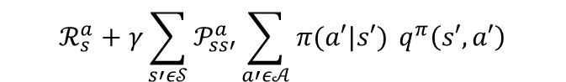
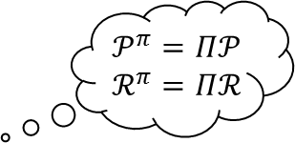
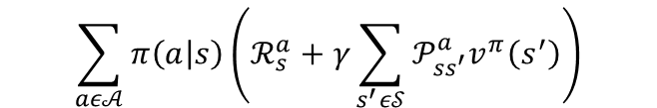
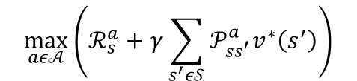


Bellman’s equations
$$𝒫^{π}=Π𝒫$$
$$ℛ^{π}=Πℛ$$
a
$v^{π}\left(s\right)=𝔼_{π,𝒫}\left[G_{t} | S_{t}=s, A_{t}\sim π\right]=𝔼_{π,𝒫}\left[R_{t+1}+γv^{π}(S_{t+1}) | S_{t}=s, A_{t+k}\sim π\right]=$
$$\sum_{aε𝒜}{π\left(a | s\right)\left(ℛ_{s}^{a}+γ\sum_{s^{′}ε𝒮}{𝒫_{ss^{′}}^{a}v^{π}\left(s^{′}\right)}\right)}$$
vector form
$$v^{π}=ℛ^{π}+γ𝒫^{π}v^{π}$$
$v^{∗}\left(s\right)=\max_{aε𝒜}{𝔼_{𝒫}\left[R_{t+1}+γv^{∗}(S_{t+1}) | S_{t}=s\right]}=$
$$\max_{aε𝒜}\left(ℛ_{s}^{a}+γ\sum_{s^{′}ε𝒮}{𝒫_{ss^{′}}^{a}v^{∗}\left(s^{′}\right)}\right)$$
$q^{π}\left(s,a\right)=𝔼_{π,𝒫}\left[G_{t} | S_{t}=s,A_{t}=a,A_{t+k}\sim π\right]=𝔼_{π,𝒫}\left[R_{t+1}+γq^{π}\left(S_{t+1},A_{t+1}\right) | S_{t}=s,A_{t}=a,A_{t+k}\sim π\right]=$
$$ℛ_{s}^{a}+γ\sum_{s′ε𝒮}{𝒫_{ss′}^{a}\sum_{a′ε𝒜}{π(a′|s′) }q^{π}\left(s′,a′\right)}$$
vector form
$$q^{π}=ℛ+γ𝒫Πq^{π}$$
$q^{∗}\left(s,a\right)=\max_{aε𝒜}{𝔼_{𝒫}\left[R_{t+1}+γq^{∗}(S_{t+1},A_{t+1}) | S_{t}=s,A_{t}=a\right]}=$
$$ℛ_{s}^{a}+γ\sum_{s′ε𝒮}{𝒫_{ss′}^{a}\max_{a′ε𝒜}{ q}^{∗}\left(s′,a′\right)}$$
Notes:
3.23, 24, 28 y 29
transition probability matrix and the expected reward vector for policy all possible deterministic policies (3.42 y 3.43)
La óptima sigue una greedy policy (3.56)

Slide 4


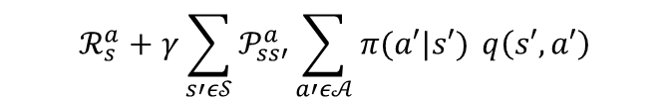
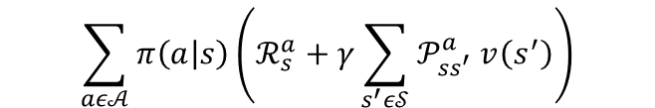

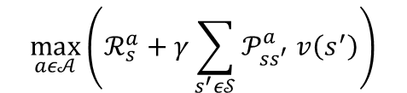


Bellman’s operator: definition
a
$\left(T_{π}v\right)\left(s\right)≜𝔼_{π,𝒫}\left[R_{t+1}+γv(S_{t+1}) | S_{t}=s, A_{t+k}\sim π\right]=$
$$\sum_{aε𝒜}{π\left(a | s\right)\left(ℛ_{s}^{a}+γ\sum_{s^{′}ε𝒮}{𝒫_{ss^{′}}^{a} v\left(s^{′}\right)}\right)}$$
vector form
$$T_{π}v$$
$(Tv)\left(s\right)≜\max_{aε𝒜}{𝔼_{𝒫}\left[R_{t+1}+γv(S_{t+1}) | S_{t}=s\right]}=$
$$\max_{aε𝒜}\left(ℛ_{s}^{a}+γ\sum_{s^{′}ε𝒮}{𝒫_{ss^{′}}^{a} v\left(s^{′}\right)}\right)$$
vector form
$$Tv$$
$\left(T_{π}q\right)\left(s,a\right)≜𝔼_{π,𝒫}\left[R_{t+1}+γq\left(S_{t+1},A_{t+1}\right) | S_{t}=s,A_{t}=a,A_{t+k}\sim π\right]=$
$$ℛ_{s}^{a}+γ\sum_{s′ε𝒮}{𝒫_{ss′}^{a}\sum_{a′ε𝒜}{π(a′|s′) }q\left(s′,a′\right)}$$
vector form
$$T_{π}q$$
$(Tq)\left(s,a\right)≜\max_{aε𝒜}{𝔼_{𝒫}\left[R_{t+1}+γq(S_{t+1},A_{t+1}) | S_{t}=s,A_{t}=a\right]}=$
$$ℛ_{s}^{a}+γ\sum_{s′ε𝒮}{𝒫_{ss′}^{a}\max_{a′ε𝒜} q\left(s′,a′\right)}$$
vector form
$$Tq$$
Notes:
Lío con la notación!!
A shorthand notation → notación taquigráfica
Mapping que transforma la función de v a S en una función de Tv a S (FUNCIONAL)
Aplicando el operador de bellman N veces convergemos a v óptima (dynamic programm)

Slide 5
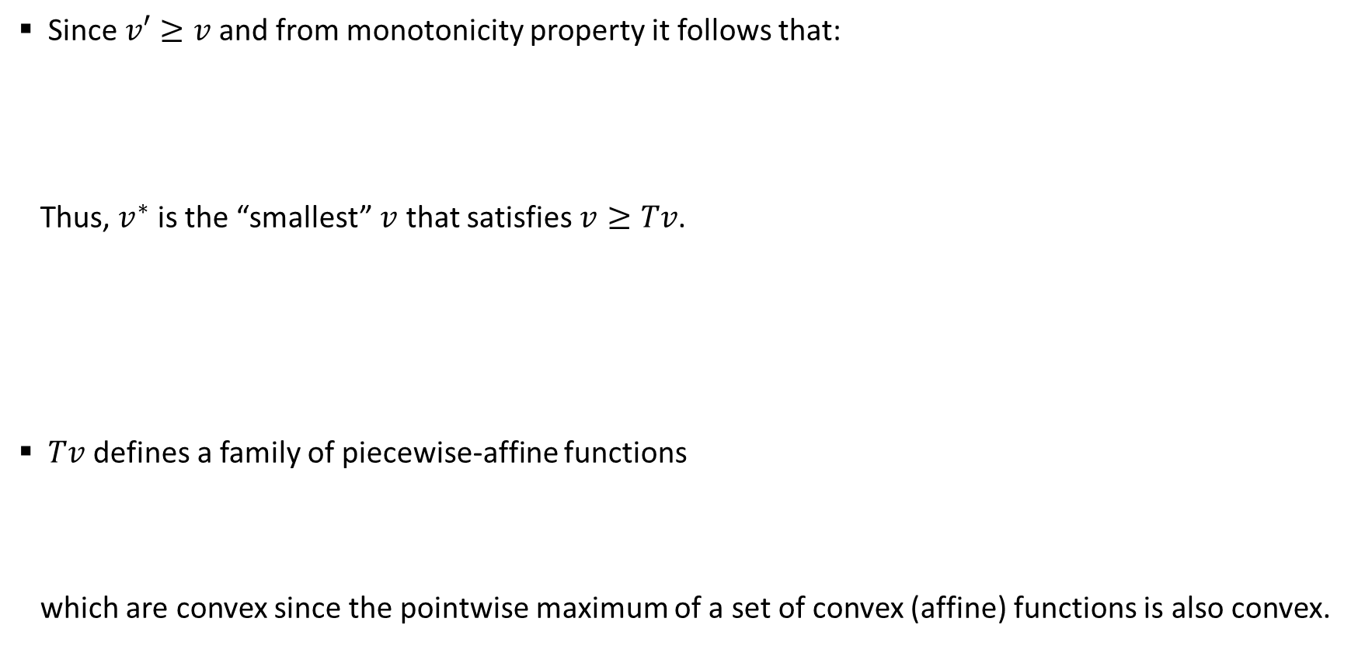
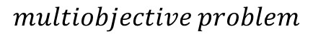
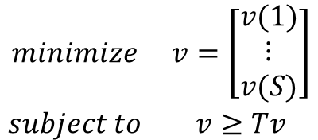
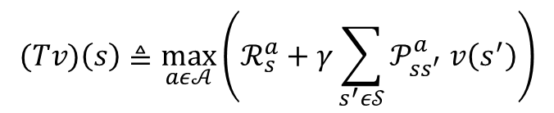
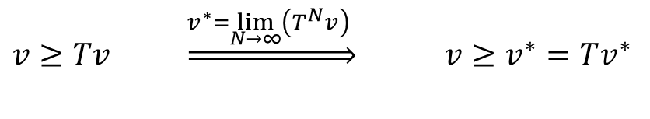
DP formulation as an LP (I)
Since$v′≥v$ and from monotonicity property it follows that:
Thus, $v^{∗}$ is the “smallest” $v$ that satisfies $v≥Tv$.
$Tv$ defines a family of piecewise-affine functions
which are convex since the pointwise maximum of a set of convex (affine) functions is also convex.
Optimal cost function condition
$v≥Tv \underset{⇒}{v^{∗}=\lim_{N→∞}\left(T^{N}v\right) }$ ${v≥v}^{∗}=Tv^{∗}$
$$\begin{matrix}minimize & v=\left[\begin{matrix}v(1) \\ \begin{matrix}⋮ \\ v(S)\end{matrix}\end{matrix}\right] \\ subject to & v≥Tv\end{matrix}$$
$$multiobjective problem$$
$$(Tv)\left(s\right)≜\max_{aε𝒜}\left(ℛ_{s}^{a}+γ\sum_{s^{′}ε𝒮}{𝒫_{ss^{′}}^{a} v\left(s^{′}\right)}\right)$$
Notes:
Multiobjective = vector optimization problem

Slide 6
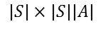
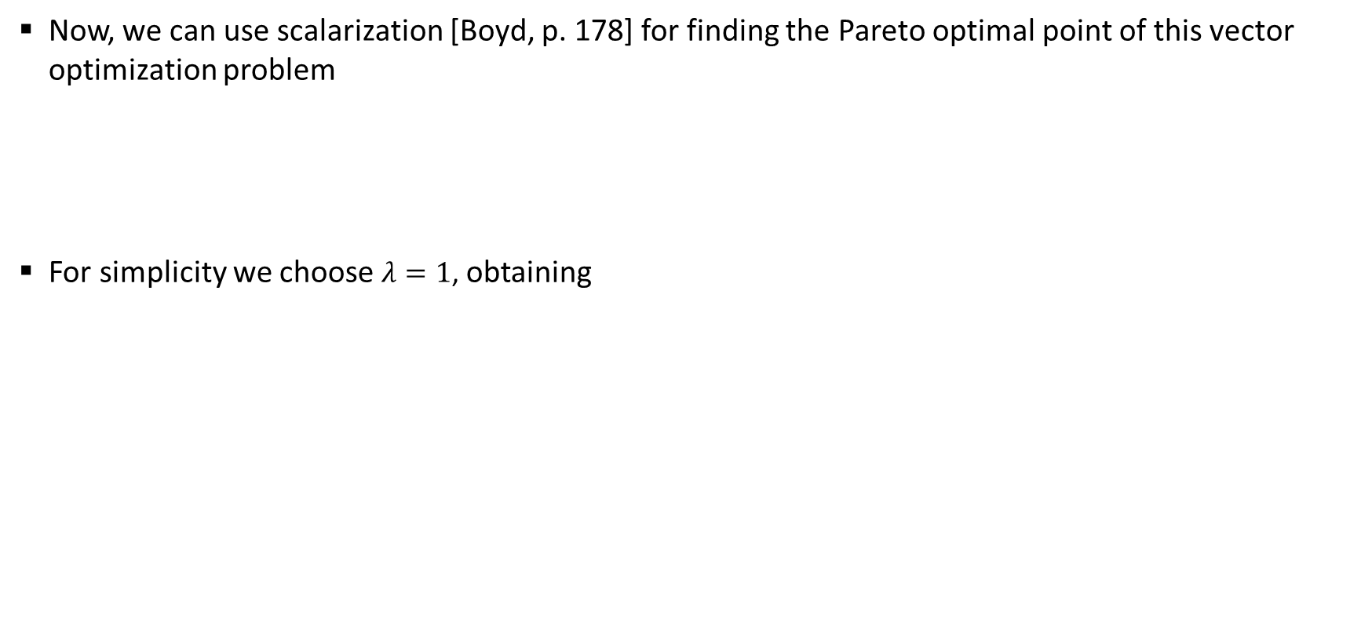
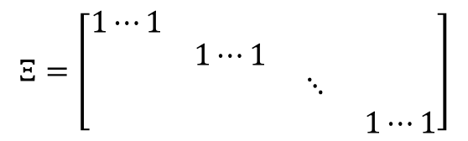

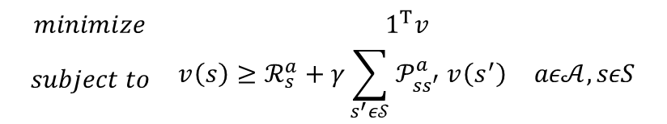
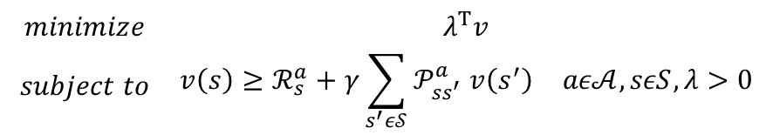
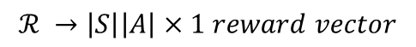
DP formulation as an LP (II)
Now, we can use scalarization [Boyd, p. 178] for finding the Pareto optimal point of this vector optimization problem
For simplicity we choose $λ=1$, obtaining
$$\begin{matrix}minimize & λ^{T}v \\ subject to & \begin{matrix}{v\left(s\right)≥ℛ}_{s}^{a}+γ\sum_{s^{′}ε𝒮}{𝒫_{ss^{′}}^{a} v\left(s^{′}\right)} & aε𝒜,sεS,λ>0\end{matrix}\end{matrix}$$
DP formulation as an LP
$$\begin{matrix}minimize & 1^{T}v \\ subject to & \begin{matrix}{v\left(s\right)≥ℛ}_{s}^{a}+γ\sum_{s^{′}ε𝒮}{𝒫_{ss^{′}}^{a} v\left(s^{′}\right)} & aε𝒜,sεS\end{matrix}\end{matrix}$$
vector form
$$\begin{matrix}minimize & 1^{T}v \\ subject to & Ξ^{T}v≥{ℛ+γ𝒫v} \end{matrix}$$
$$ℛ →\left|S\right|\left|A\right|×1 reward vector$$
$$Ξ=\left[\begin{matrix}1⋯1 & \begin{matrix}1⋯1 & 11 & 1⋯1\end{matrix} \\ \begin{matrix}1⋯1 \\ \begin{matrix}1⋯1 \\ 1⋯1\end{matrix}\end{matrix} & \begin{matrix}\begin{matrix}1⋯1 \\ \begin{matrix}1⋯1 \\ 1⋯1\end{matrix}\end{matrix} & \begin{matrix}\begin{matrix}11 & 1⋯1\end{matrix} \\ \begin{matrix}\begin{matrix}⋱ & 1⋯1\end{matrix} \\ \begin{matrix}11 & 1⋯1\end{matrix}\end{matrix}\end{matrix}\end{matrix}\end{matrix}\right]$$
$$𝒫 →\left|S\right|\left|A\right|×\left|S\right| transition matrix$$
$$|S|×|S||A|$$
$$v →\left|S\right|×1 state value function vector$$
Notes:
Multiobjective = vector optimization problem

Slide 7
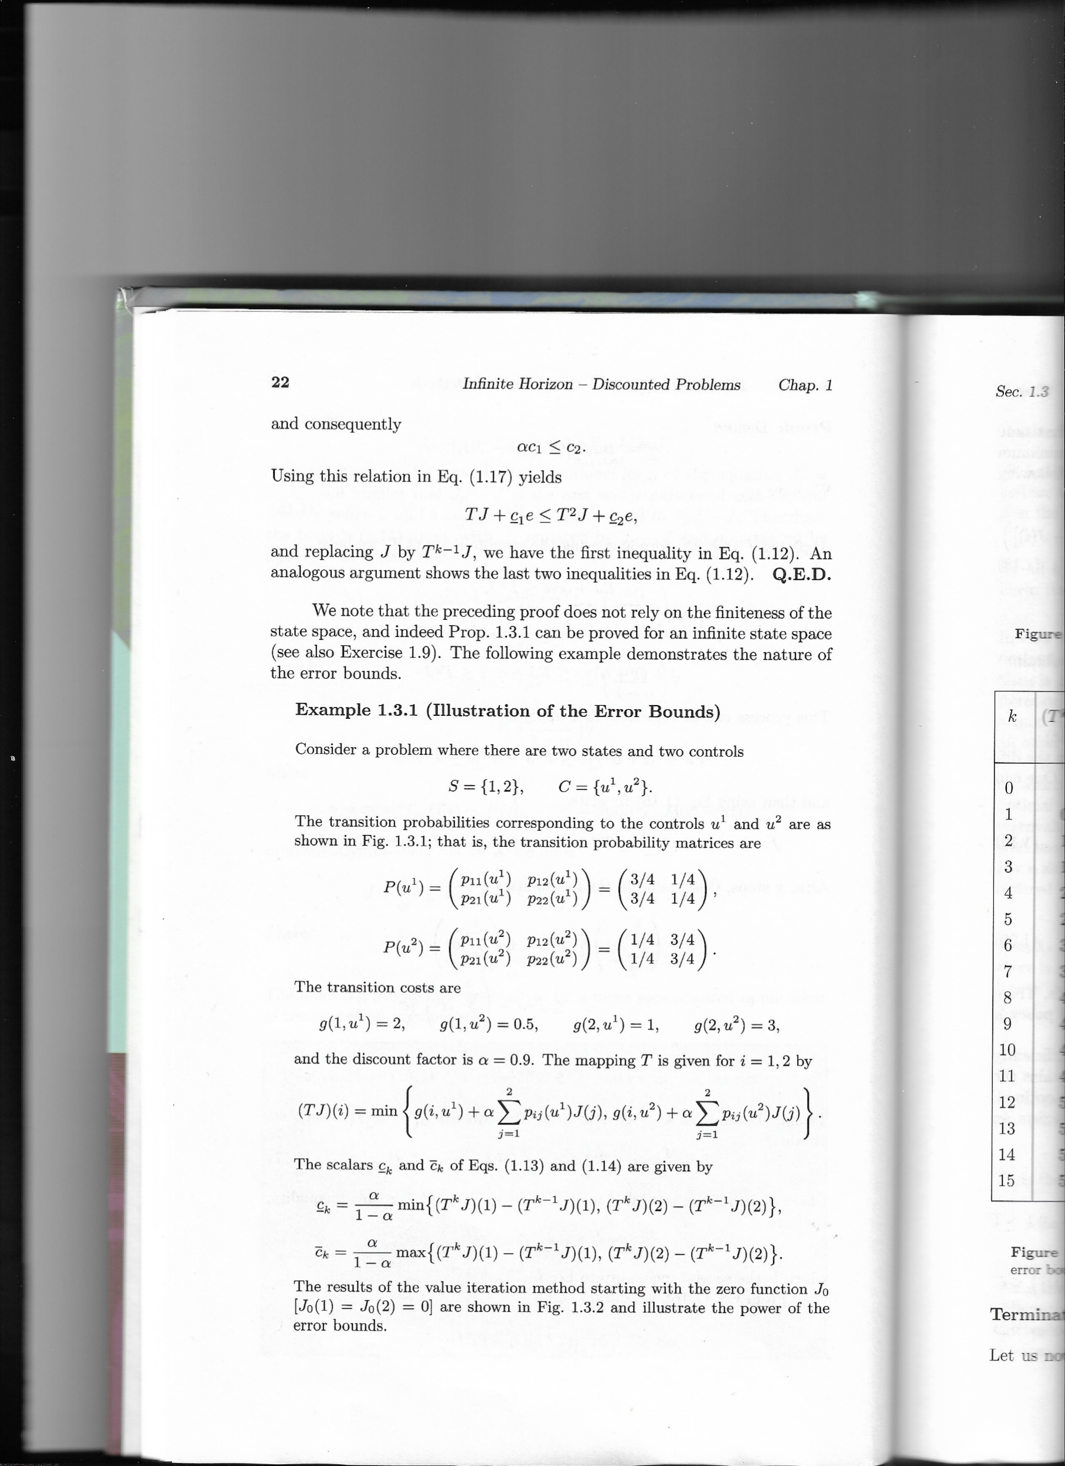

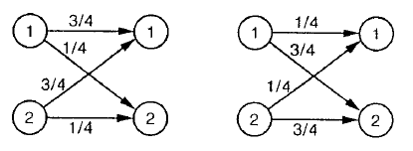
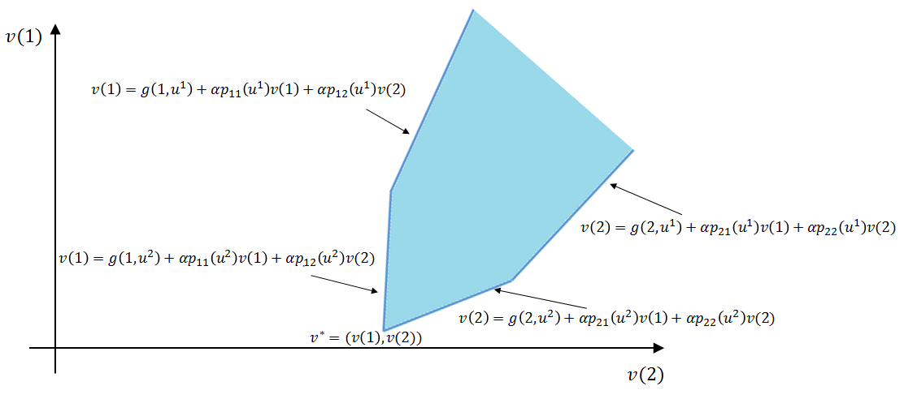
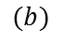
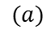
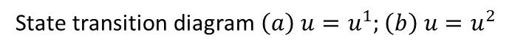
DP formulation as an LP (IV)
In order to summar
$$(a)$$
$$(b)$$
State transition diagram $\left(a\right) u=u^{1};\left(b\right) u=u^{2}$
Notes:
El state transition diagram muestra las transition probabilities corresponding to the controls u1 and u2

Slide 8
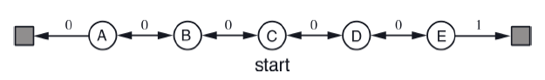
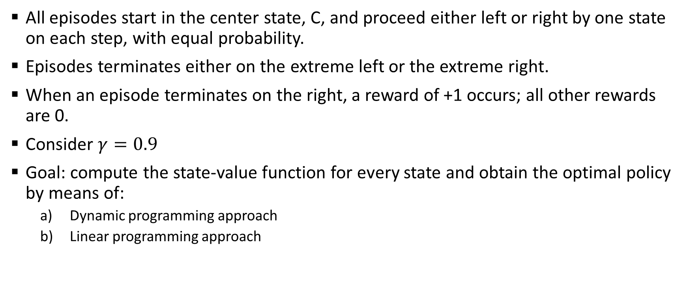
Example: random walk problem
All episodes start in the center state, C, and proceed either left or right by one state on each step, with equal probability.
Episodes terminates either on the extreme left or the extreme right.
When an episode terminates on the right, a reward of +1 occurs; all other rewards are 0.
Consider $γ=0.9$
Goal: compute the state-value function for every state and obtain the optimal policy by means of:
Dynamic programming approach
Linear programming approach
T1
T2

Slide 9
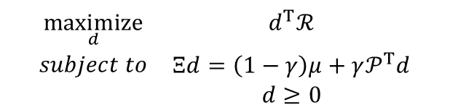
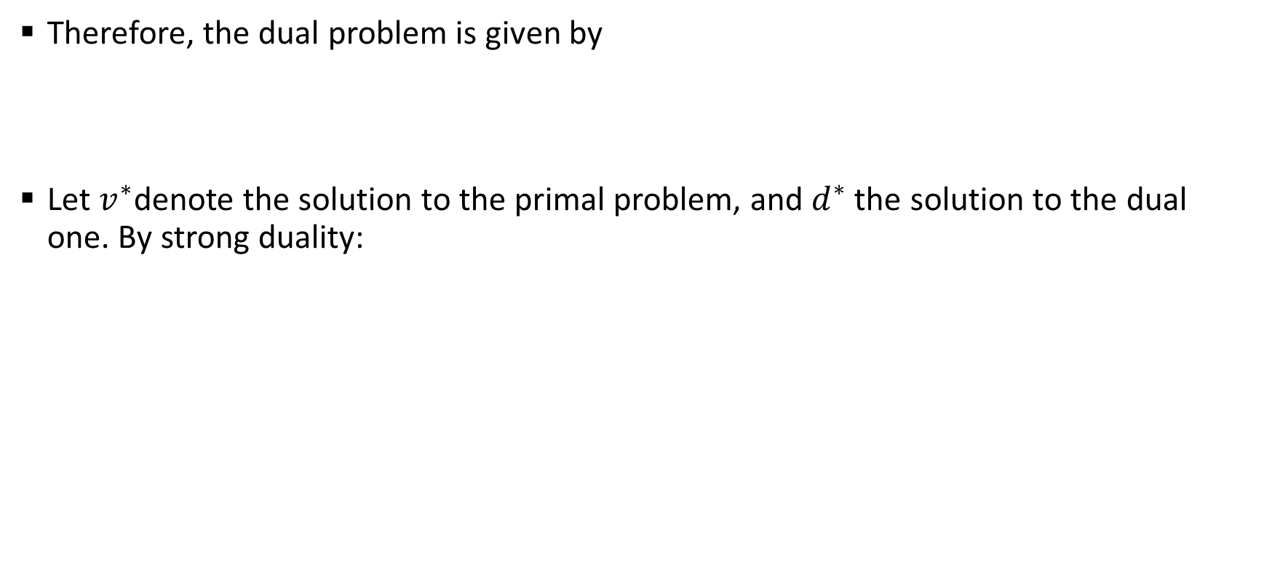
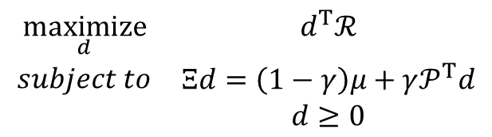
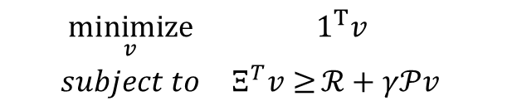
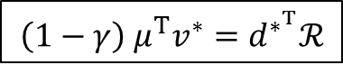
Dual representation of the LP approach
Therefore, the dual problem is given by
Let $v^{∗}$denote the solution to the primal problem, and $d^{∗}$ the solution to the dual one. By strong duality:
$$\begin{matrix}\underset{d}{maximize} & d^{T}ℛ \\ \begin{aligned}subject to \\ \end{aligned} & \begin{matrix}Ξd=\left(1−γ\right)μ+γ𝒫^{T}d \\ d≥0\end{matrix}\end{matrix}$$
$$\begin{matrix}\underset{v}{minimize} & 1^{T}v \\ subject to & Ξ^{T}v≥{ℛ+γ𝒫v} \end{matrix}$$
$$\begin{matrix}\underset{d}{maximize} & d^{T}ℛ \\ \begin{aligned}subject to \\ \end{aligned} & \begin{matrix}Ξd=\left(1−γ\right)μ+γ𝒫^{T}d \\ d≥0\end{matrix}\end{matrix}$$
PRIMAL PROBLEM
DUAL PROBLEM
$$\left(1−γ\right) μ^{T}v^{∗}=d^{∗^{T}}ℛ$$
STRONG DUALITY

Slide 10
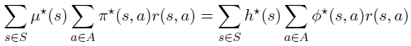
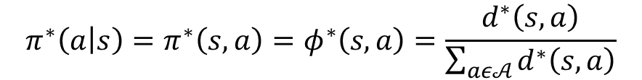
Why using dual representation?
Using the strong duality condition and unrolling both sides, we get
We conclude that we can obtain the optimal policy from the optimal dual variable
$$π^{∗}\left(a | s\right)=π^{∗}\left(s,a\right)=φ^{∗}\left(s,a\right)=\frac{d^{∗}\left(s,a\right)}{\sum_{aε𝒜}{d^{∗}\left(s,a\right)}}$$
While the primal linear problem searches the optimal value, the dual formulation searches in the policy space

Slide 11
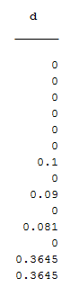
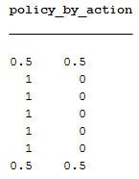
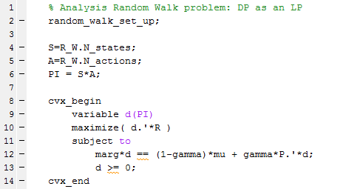
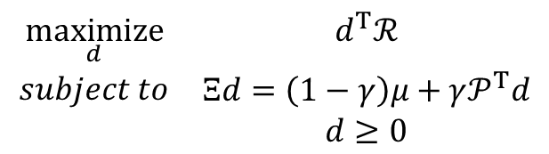

Example: random walk problem (cont.)
Solving the dual problem we obtain the same results as the primal and value iteration
$$\begin{matrix}\underset{d}{maximize} & d^{T}ℛ \\ \begin{aligned}subject to \\ \end{aligned} & \begin{matrix}Ξd=\left(1−γ\right)μ+γ𝒫^{T}d \\ d≥0\end{matrix}\end{matrix}$$
DUAL PROBLEM
$$π^{∗}\left(a | s\right)=\frac{d^{∗}\left(s,a\right)}{\sum_{aε𝒜}{d^{∗}\left(s,a\right)}}$$
a1 = right
a2 = left

Slide 12
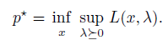
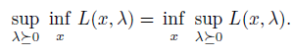
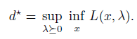
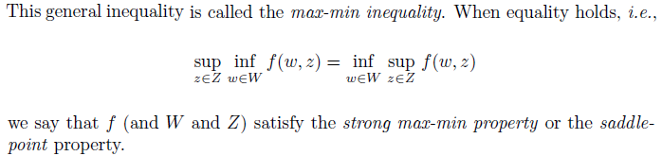
Dual methods for solving the DP: saddle point (I)
By strong duality, we can express:
The order of the minimization over x and the maximization over λ>0 can be switched without affecting the result

Slide 13
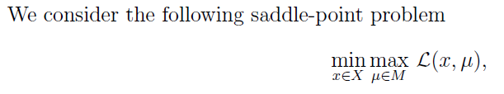
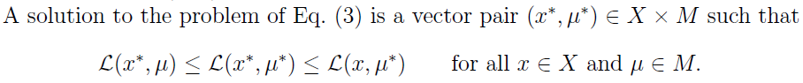
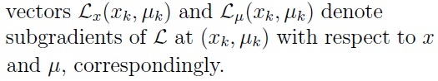
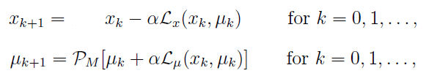

Dual methods for solving the DP: saddle point (II)
Possibility of doing an stochastic gradient → Arrow-Hurwicz algorithm
To generate approximate solutions to problem (3), we consider a subgradient method motivated by Arrow-Hurwicz algorithm. The method has the following form:
$P_{M}$ the projection over the set M, in this case the set of positive number

Slide 14
Dual methods for solving the DP: saddle point (III)
Both solutions (Lagrangian of primal and dual problem) highly oscillating. Never convergence was reached.
Tried the equivalent problem with CVX when v/d fixed and neither convergence was reached.
New suggestion: DUAL ASCENT

Slide 15
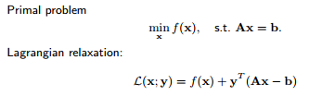
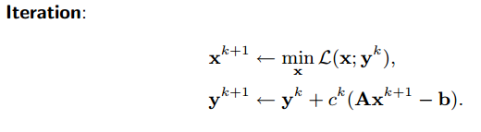
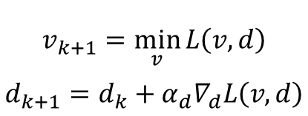
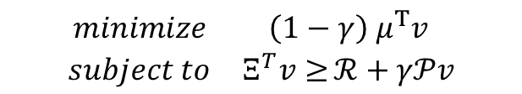
Dual methods for solving the DP: dual ascent (I)
$$\begin{matrix}minimize & \left(1−γ\right) μ^{T}v \\ subject to & Ξ^{T}v≥{ℛ+γ𝒫v}\end{matrix}$$
$$L\left(v,d\right)=\left(1−γ\right) μ^{T}v+d^{T}(ℛ+γ𝒫v−Ξ^{T}v)$$
$$v_{k+1}=\min_{v}{L\left(v,d\right)}$$
$$d_{k+1}=d_{k}+α_{d}∇_{d}L\left(v,d\right)$$
[http://www.math.ucla.edu/~wotaoyin/summer2013/slides/Lec07_Dual_Methods_part_1.pdf]

Slide 16
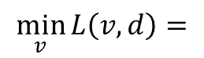




Dual methods for solving the DP: dual ascent (II)
$$v_{k+1}=\min_{v}{L\left(v,d\right)}$$
$$d_{k+1}=d_{k}+α_{d}∇_{d}L\left(v,d\right)$$
Both minimization methods showed convergence
Better using temporal difference (TD) → suitable for sthocastic gradient descent
Model-based method
¡Policy $Π$ extracted from d!
$$v_{k+1}={\left(I−γΠP\right)}^{−1}ΠR$$
$$∇_{d}L\left(v,d\right)=ℛ+γ𝒫v−Ξ^{T}v$$
$$\min_{v}{L\left(v,d\right)}=$$
Model-free method (TD)

Slide 17



Dual methods for solving the DP: dual ascent (III)
For exp = 1:numExperiments
Random initialization of d and v
For rep = 1:numRepetitions
For epi = 1:numEpisodes
set initial state
while notTerminal
select action (ε-d)
get next state
$v_{k+1}(s)=v_{k}(s)+α_{td}[ℛ\left(s,a,s^{′}\right)+γv\left(s^{′}\right)−v\left(s\right)]$
collect episode transitions (s, a, s’, r)
end
end
For the same numEpisodes and same collected transitions
$d_{k+1}(s,a)=d_{k}(s,a)+α_{d}[ℛ\left(s,a,s^{′}\right)+γ\sum_{s′}{𝒫\left(s^{′}|s,a\right)v\left(s^{′}\right)}−v\left(s\right)]$,
end
end
end
numExperiments independent experiments…
….of numRepetitions repetitions of a set of…
….numEpisodes episodes.
Each set of numEpisodes episodes iterates, first over v, to assure convergence of v, and then over d, to assure convergence of d.
Each numEpisodes episode is a policy improvement.
Each numRepetitions repetitons is composed by policy evaluation (v loop) and policy improvement (d loop)
$$if d_{k+1}<0 →d_{k+1}=0$$
$$a=\left\{\begin{aligned}\begin{matrix}rand(A) & with p=ε\end{matrix} \\ \begin{matrix}d(s,A) & with p=1−ε\end{matrix}\end{aligned}\right.$$
select action (ε-d)
Notes:
El búcle de la v sería policy evaluation y el de la d policy improvement

Slide 18
Content
Last presentation review
TESTING THE DUAL-ASCENT ALGORITHM: RANDOM WALK PROBLEM (MODIFIED)
Future lines (06/04/2017)

Slide 19

Example: random walk problem (dual ascent)
Modified version
Nstates/2 states with random reward between 1 and 2. Last state on the right more reward, 150, to assure convergence.
Nstates parametrizable (Nstates = 13 was chosen for testing)
Random transition matrix (i.e: when action is “left”, you go left with $p_{left}=0.8−1$ probability and right with$p_{right}=1−p_{left}$ probability)
T1
T2

Slide 20
Calibration (I)
Dual ascent algorithm composed by 2 steps:
Policy evaluation (minimization of v – TD approach)
Policy improvement (maximization of d – dual variable representing the policy)
Necessary a calibration process
Assure TD/policy evaluation convergence
Assure policy convergence in dual-ascent algorithm for exact method (model-based).
Assure policy convergence in dual-ascent algorithm for TD method (model-free, stochastic gradient)

Slide 21


Calibration (II)
Assure TD/policy evaluation convergence
Find optimal $α_{TD}$ (TD stepzize) for 3 policies:
Optimal policy
Optimal $ε$-greedy policy ($ε=0.2$)
Random policy
Expected to model the dual-ascent behaviour during execution
(beginning with a random policy, following an $ε$-greedy one, and finally convergence to the optimal policy)
Notes:
El episodio en el que convergía se determinaba a partir de la convergencia de la v (es decir, de la convergencia de TD).
Con esto vemos que, si inicializamos nuestro algoritmo con una política aleatoria, necesitaremos aproximadamente 50 episodios para la convergencia de TD.
En cuanto al valor de alfa, no se puede determinar ya que se pasa rápidamente de rand a optimal-greedy, así que en principio puede ser un rango muy amplio de alfas.
Se supone que nunca vamos a necesitar tantísimos episodios como indica la óptima porque siempre iniciamos aleatoriamente, lo cual da un carácter explorador inicial.

Slide 22





Calibration (III)
Assure policy convergence in dual-ascent algorithm for exact method (model-based)
Find optimal parameters ($numEpisodes, α_{D}, ε$)
Optimal parameters where chosen for best policy convergence
$$\min_{numEpisodes, α_{D}, ε}{({π−π}^{∗})}$$
$$v_{k+1}=\min_{v}{L\left(v,d\right)}$$
$$d_{k+1}=d_{k}+α_{d}∇_{d}L\left(v,d\right)$$
$$v_{k+1}={\left(I−γΠP\right)}^{−1}ΠR$$
$$d_{k+1}(s,a)=d_{k}(s,a)+α_{d}[ℛ\left(s,a,s^{′}\right)+γ\hat{v}\left(s′\right)−\hat{v}\left(s\right)]$$
$$π \left(a | s\right)=\frac{d\left(s,a\right)}{\sum_{aε𝒜}{d^{∗}\left(s,a\right)}}$$

Slide 23
Calibration (IV)
Assure policy convergence in dual-ascent algorithm for exact method (model-based)

Slide 24

Calibration (V)
Assure policy convergence in dual-ascent algorithm for exact method (model-based) → optimal parameters ($numEpisodes, α_{D}, ε$)
numExperiments = 50;
numRep = 1000;
numEpisodes = 1;
epsilon = 0.2;
alphaD = 0.05;

Slide 25

Calibration (VI)
Assure policy convergence in dual-ascent algorithm for TD method (model-free, stochastic gradient) → optimal parameters ($numEpisodes, α_{D},α_{TD}ε$)
numExperiments = 50;
numRep = 50;
numEpisodes = 50;
epsilon = 0.4;
alphaD = 0.05;
alphaTD = 0.4;

Slide 26
Comparison
Comparison between dual ascent (DA) exact (model-based), DA TD (model-free), SARSA and Q-learning. All of them with optimal parameters.

Slide 27
About Arrow-Hurwicz algorithm…(I)
As it could be seen, iteration over d worked with dual ascent
In order to check again Arrow-Hurwicz algorithm, we repeated last tests with the following iteration:

Slide 28


About Arrow-Hurwicz algorithm…(II)
For exp = 1:numExperiments
Random initialization of d and v
For rep = 1:numRepetitions
For epi = 1:numEpisodes
set initial state
while notTerminal
select action (pseudo ε-greedy)
get next state
collect episode transitions (s, a, s’, r)
end
end
For the same numEpisodes and same collected transitions
$d_{k+1}(s,a)=d_{k}(s,a)+α_{d}[ℛ\left(s,a,s^{′}\right)+γv\left(s′\right)−v\left(s\right)]$,
end
end
end
NOT SUCCESSFUL
$$v_{k+1}=v_{k}−α_{v}∇_{v}L\left(v,d\right)$$
$$if d_{k+1}<0 →d_{k+1}=0$$

Slide 29
Content
Last presentation review
Testing the dual-ascent algorithm: random walk problem (modified)
FUTURE LINES (06/04/2017)

Slide 30
Future lines (06/04/2017)
The milestones for next meeting are…
Reinforcement Learning in Large and continuous spaces. Linear approximation
Motivation
Families of basis functions
Projected Bellman Equation

